Slide 1
Chapter 14
Artistic Innovations in Fifteenth-Century Northern Europe

Slide 2
Learning Objectives
Examine the characteristics of the luxurious International Gothic.
Discover the detailed naturalism and innovative techniques associated with Netherlandish painting in the fifteenth century.
Analyze the imagery and complex symbolism of Netherlandish paintings.
Trace the spread of Netherlandish styles into other regions of Northern Europe.
Explore the origins of print media.

Slide 3
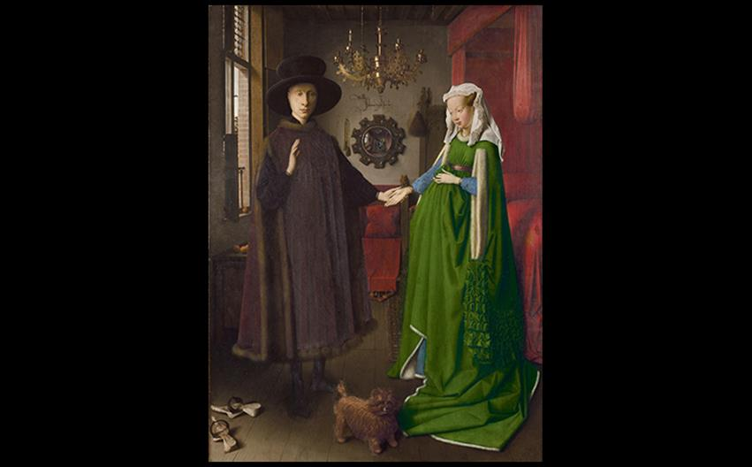
Jan van Eyck DOUBLE PORTRAIT OF GIOVANNI ARNOLFINI AND HIS WIFE 1434. Oil on wood panel, 33" × 22-1/2" (83.8 × 57.2 cm). The National Gallery, London. © 2016. Copyright The National Gallery, London/Scala, Florence
Notes:
Jan van Eyck DOUBLE PORTRAIT OF GIOVANNI ARNOLFINI AND HIS WIFE 1434. Oil on wood panel, 33" × 22-1/2" (83.8 × 57.2 cm). The National Gallery, London. © 2016. Copyright The National Gallery, London/Scala, Florence

Slide 4
The Northern Renaissance
Closely observing and detailing nature accurately through art became popular.
The concept of individual personalities also rose to prominence, and more artists began to sign their work.
The new power of Flanders and the greater Netherlands began to challenge the traditions of the Church.

Slide 5
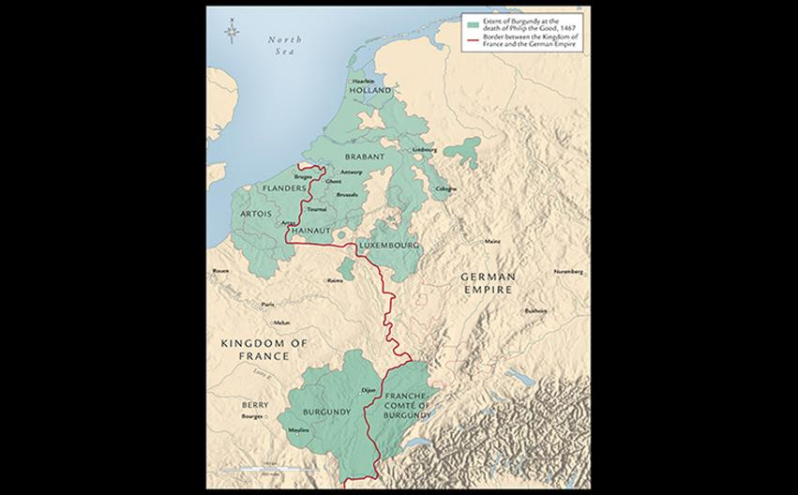
FIFTEENTH-CENTURY NORTHERN EUROPE The dukes of Burgundy—whose territory included much of present-day Belgium and Luxembourg, the Netherlands, and eastern France—became the cultural and political leaders of western Europe. Their major cities of Bruges (Belgium) and Dijon (France) were centers of art and industry as well as politics.
Notes:
FIFTEENTH-CENTURY NORTHERN EUROPE The dukes of Burgundy—whose territory included much of present-day Belgium and Luxembourg, the Netherlands, and eastern France—became the cultural and political leaders of western Europe. Their major cities of Bruges (Belgium) and Dijon (France) were centers of art and industry as well as politics.

Slide 6
Art for the French Ducal Courts
The dukes of Burgundy's rule encompassed Flemish and Netherlandish cities as well.
Dukes became the arbiters of taste.
A composite style called the International Gothic prevailed in late fourteenth-century Europe.

Slide 7
Painting and Sculpture for the Chartreuse de Champmol (1 of 2)
Philip the Bold sponsored the building of the chartreuse at Champmol.
Melchior Broederlam
The altarpiece called for scenes of the Adoration of the Magi, Crucifixion, and Entombment, which Broederlam renders in the International Style.

Slide 8
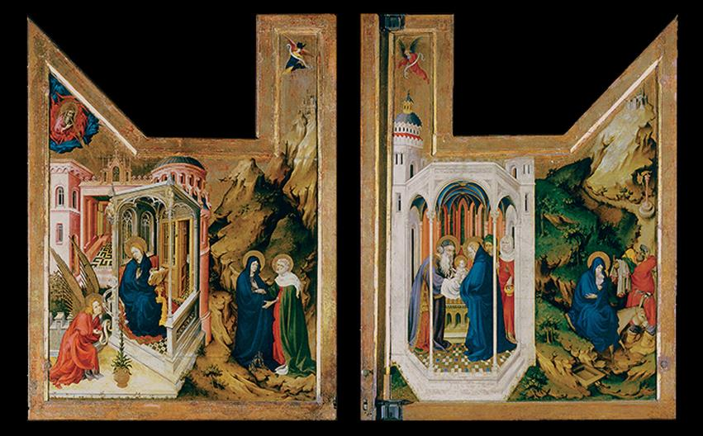
Melchior Broederlam ANNUNCIATION, VISITATION, PRESENTATION IN THE TEMPLE, AND FLIGHT INTO EGYPT Exterior of the wings of the altarpiece of the Chartreuse de Champmol. 1393–1399. Oil on wood panel, 5'5-3/4" × 4'1-1/4" (1.67 × 1.25 m). Musée des Beaux-Arts, Dijon. © akg-images/Erich Lessing.
Notes:
Melchior Broederlam ANNUNCIATION, VISITATION, PRESENTATION IN THE TEMPLE, AND FLIGHT INTO EGYPT Exterior of the wings of the altarpiece of the Chartreuse de Champmol. 1393–1399. Oil on wood panel, 5'5-3/4" × 4'1-1/4" (1.67 × 1.25 m). Musée des Beaux-Arts, Dijon. © akg-images/Erich Lessing.

Slide 9
Art and Its Contexts: Alters and Alterpieces
As a table, the altar is a site where priests celebrate Mass.
Altarpieces are painted, carved, and placed at the back of the altar so that they appear to join to the altar itself.
A winged altarpiece could be a diptych, triptych, or polyptych, consisting of many panels.

Slide 10
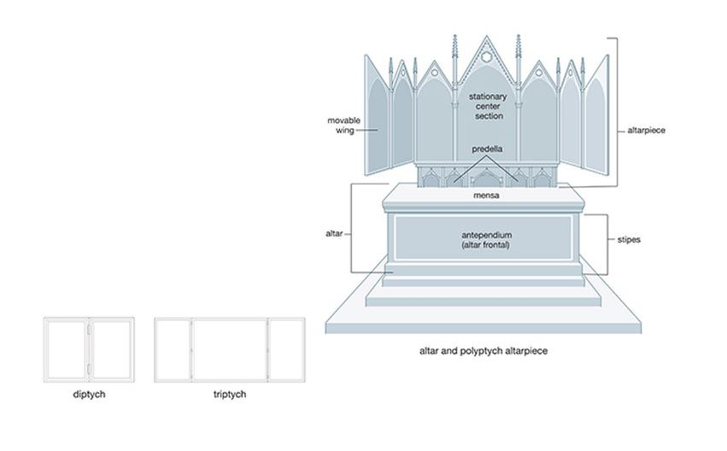
ART AND ITS CONTEXTS: Altars and Alterpieces Kathy Mrozek
Notes:
ART AND ITS CONTEXTS: Altars and Alterpieces Kathy Mrozek

Slide 11
Painting and Sculpture for the Chartreuse de Champmol (2 of 2)
Claus Sluter
Sluter left the complex Well of Moses unfinished at the time of his death.
Figures of patriarchs and prophets serve as a pedestal for a free-standing figure of Christ on the cross.
He sculpted figures with voluminous drapery that created horizontal folds across their bodies.

Slide 12
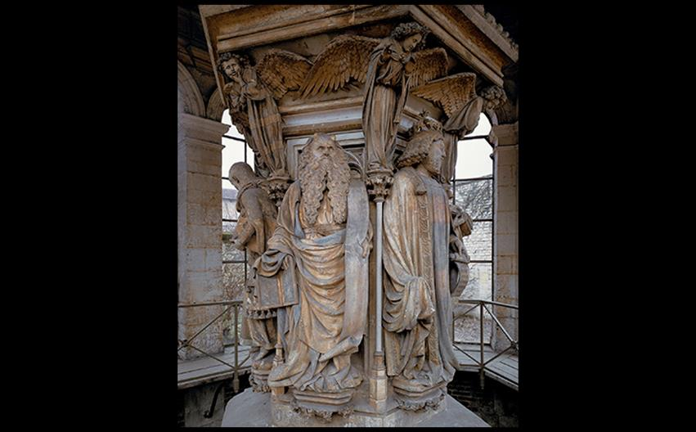
Claus Sluter WELL OF MOSES, DETAIL OF MOSES AND DAVID The Chartreuse de Champmol, Dijon, France. 1395–1406. Limestone with traces of paint, height of figures about 5'8" (1.69 m). © Paul M.R. Maeyaert.
Notes:
Claus Sluter WELL OF MOSES, DETAIL OF MOSES AND DAVID The Chartreuse de Champmol, Dijon, France. 1395–1406. Limestone with traces of paint, height of figures about 5'8" (1.69 m). © Paul M.R. Maeyaert.

Slide 13
Manuscript Illumination (1 of 4)
Wealthy patrons treasured volumes of secular writing as well as religious texts.
Only the most lavish books would have full-page miniature paintings set off with frames.
They were conceived as windows looking out at landscapes.

Slide 14
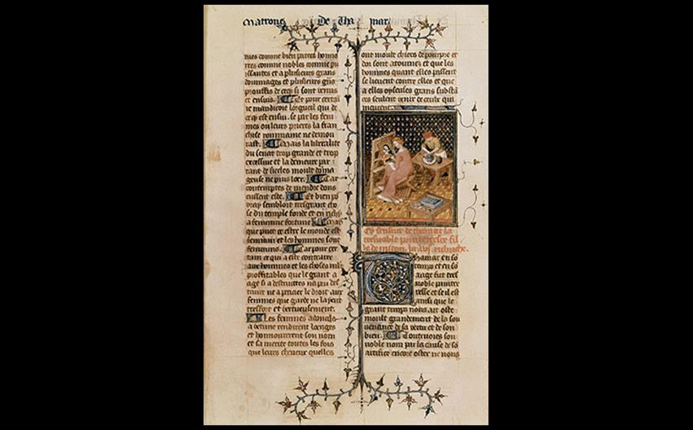
PAGE WITH A MINIATURE PAINTING OF THAMYRIS From Giovanni Boccaccio's De Claris Mulieribus (Concerning Famous Women). 1402. Ink and tempera on vellum, 14 × 91⁄2″ (35.5 × 24 cm). Bibliothèque Nationale, Paris. Bibliothèque Nationale de France, Paris.
Notes:
PAGE WITH A MINIATURE PAINTING OF THAMYRIS From Giovanni Boccaccio's De Claris Mulieribus (Concerning Famous Women). 1402. Ink and tempera on vellum, 14 × 91⁄2″ (35.5 × 24 cm). Bibliothèque Nationale, Paris. Bibliothèque Nationale de France, Paris.

Slide 15
Manuscript Illumination (2 of 4)
The Limbourg Brothers
Three brothers became famous for their miniature paintings.
On the February page of Très Riches Heures, farmers relax before a fire.
Gothic conventions still seen in this work include the cutaway view of the house, attention to anecdotal detail, and the high placement of the horizon line.

Slide 16
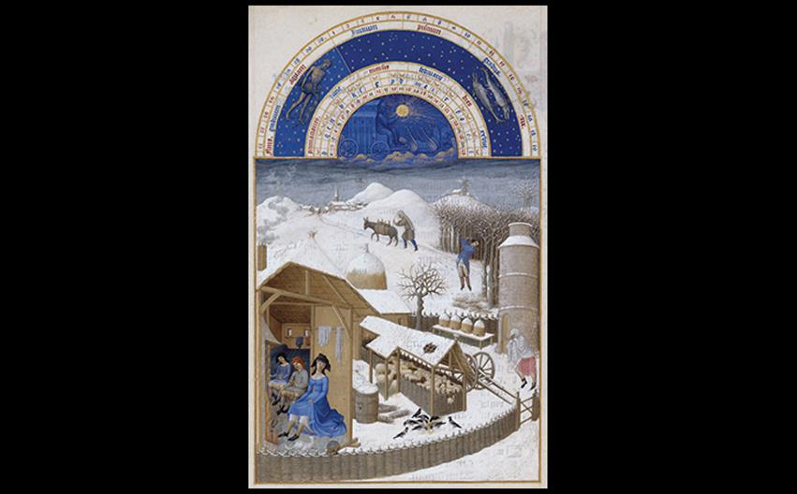
Paul, Herman, and Jean Limbourg FEBRUARY: LIFE IN THE COUNTRY, TRÈS RICHES HEURES 1411–1416. Colors and ink on parchment, 11-3/8" × 8-1/4" (29 × 21 cm). Musée Condé, Chantilly, France. Photo © RMN-Grand Palais/René-Gabriel Ojéda.
Notes:
Paul, Herman, and Jean Limbourg FEBRUARY: LIFE IN THE COUNTRY, TRÈS RICHES HEURES 1411–1416. Colors and ink on parchment, 11-3/8" × 8-1/4" (29 × 21 cm). Musée Condé, Chantilly, France. Photo © RMN-Grand Palais/René-Gabriel Ojéda.

Slide 17
Manuscript Illumination (3 of 4)
The Limbourg Brothers
The January page depicts an aristocratic household, barely hinting of the harsh winter represented in the previous work.
Luxury items attest to the wealth and lavish lifestyle of this patron of the arts.

Slide 18
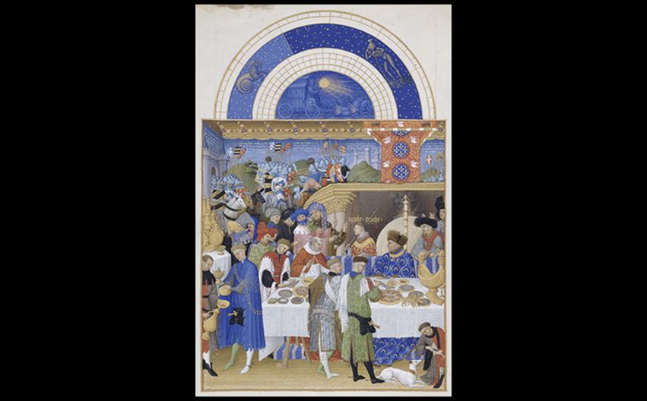
Paul, Herman, and Jean Limbourg JANUARY: THE DUKE OF BERRY AT TABLE, TRÈS RICHES HEURES 1411–1416. Colors and ink on parchment, 11-3/8" × 8-1/4" (29 × 21 cm). Musée Condé, Chantilly, France. Photo © RMN-Grand Palais/René-Gabriel Ojéda.
Notes:
Paul, Herman, and Jean Limbourg JANUARY: THE DUKE OF BERRY AT TABLE, TRÈS RICHES HEURES 1411–1416. Colors and ink on parchment, 11-3/8" × 8-1/4" (29 × 21 cm). Musée Condé, Chantilly, France. Photo © RMN-Grand Palais/René-Gabriel Ojéda.

Slide 19
Manuscript Illumination (4 of 4)
The Mary of Burgundy Painter
The painting of Mary at Her Devotions shows viewers two windows: one is the frame of the painting itself, and the other is a view into the far reaches of the church interior.
The message is of private faith.
Christians of this time were encouraged to imagine themselves within biblical events to feel a stronger connection.

Slide 20
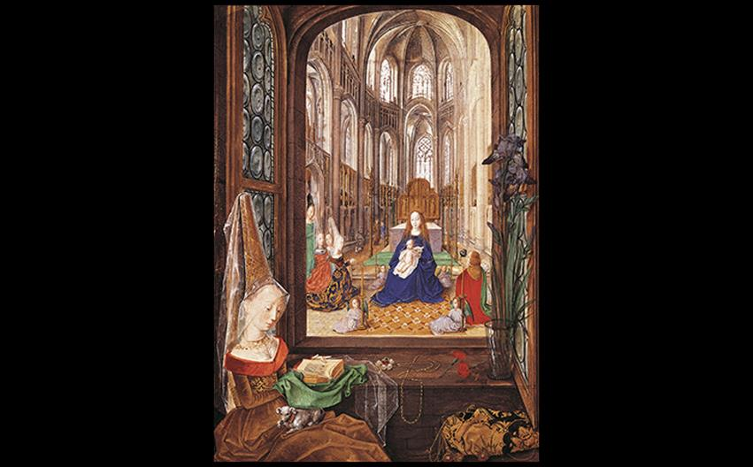
Mary of Burgundy Painter MARY AT HER DEVOTIONS, HOURS OF MARY OF BURGUNDY Before 1482. Colors and ink on parchment, size of image 7 1/2" × 5 1/4" (19.1 × 13.3 cm). Österreichische Nationalbibliothek, Vienna. © 2016. DeAgostini Picture Libary/Scala, Florence.
Notes:
Mary of Burgundy Painter MARY AT HER DEVOTIONS, HOURS OF MARY OF BURGUNDY Before 1482. Colors and ink on parchment, size of image 7 1/2" × 5 1/4" (19.1 × 13.3 cm). Österreichische Nationalbibliothek, Vienna. © 2016. DeAgostini Picture Libary/Scala, Florence

Slide 21
Textiles (1 of 3)
Flemish textiles were treasured arts of the Renaissance.
They were portable, displayable symbols of wealth as well as practical means of warmth.

Slide 22
Textiles (2 of 3)
The Unicorn Tapestry
The Unicorn is Found section of the Hunt of the Unicorn was preserved.
Subtle modeling indicates virtuosity of the weaver.
The natural world has symbolic meaning for the Resurrection in the lions and stag.
Plants and the unicorn itself carry other meaning as well.

Slide 23
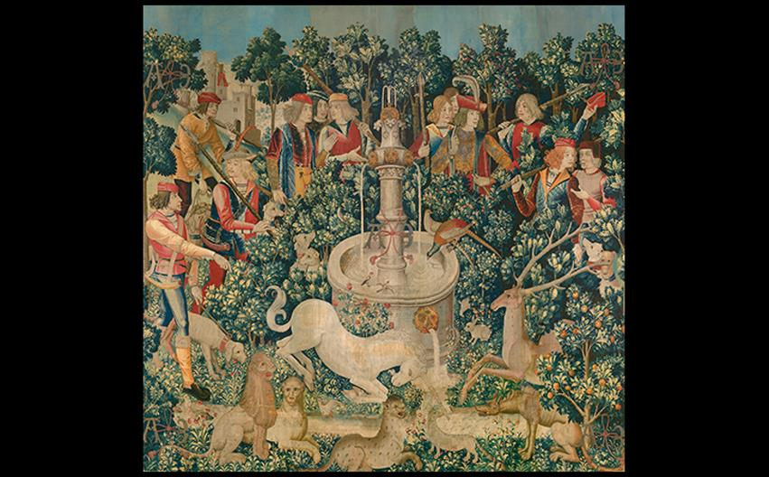
UNICORN IS FOUND AT THE FOUNTAIN From the Hunt of the Unicorn tapestry series. c. 1495–1505. Wool, silk, and silver- and gilt-wrapped thread (13-21 warp threads per inch), 12'1" × 12'5" (3.68 × 3.78 m). Metropolitan Museum of Art, New York. Gift of John D. Rockefeller Jr., The Cloisters Collection, 1937 (37.80.2). © 2016. Image copyright The Metropolitan Museum of Art/Art Resource/Scala, Florence.
Notes:
UNICORN IS FOUND AT THE FOUNTAIN From the Hunt of the Unicorn tapestry series. c. 1495–1505. Wool, silk, and silver- and gilt-wrapped thread (13-21 warp threads per inch), 12'1" × 12'5" (3.68 × 3.78 m). Metropolitan Museum of Art, New York. Gift of John D. Rockefeller Jr., The Cloisters Collection, 1937 (37.80.2). © 2016. Image copyright The Metropolitan Museum of Art/Art Resource/Scala, Florence.

Slide 24
Textiles (3 of 3)
Cope of the Order of the Golden Fleece
This cloak served as a vestment for religious services.
Embroiderers worked with precision to match illusionistic effects being produced by contemporary Flemish painting.

Slide 25
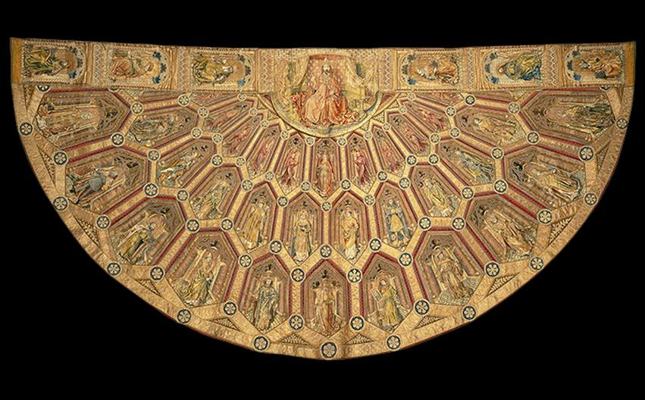
COPE OF THE ORDER OF THE GOLDEN FLEECE Flemish. Mid 15th century. Cloth with gold and colored silk embroidery, 5'4-9/16" × 10'9-5/16" (1.64 × 3.3 m). Imperial Treasury, Vienna. © KHM-Museumsverband.
Notes:
COPE OF THE ORDER OF THE GOLDEN FLEECE Flemish. Mid 15th century. Cloth with gold and colored silk embroidery, 5'4-9/16" × 10'9-5/16" (1.64 × 3.3 m). Imperial Treasury, Vienna. © KHM-Museumsverband.

Slide 26
Technique: Oil Painting
Limitations of tempera paint resulted in the Flemish preference for oil paint.
It is a viscous medium that has time to smooth out during the drying process.
Additionally, it can be applied in thin layers called glazes that can create the appearance of an interior glow.

Slide 27
Painting in Flanders
Civic groups, town councils, and wealthy merchants were important patrons in the Netherlands.
Guilds oversaw nearly every aspect of members' lives.
Artists who moved from one city to another had to work as assistants until being granted guild membership, regardless of experience.

Slide 28
The Master of Flémalle (1 of 2)
Robert Campin is identified as some art historians as being this master.
The Mèrode Altarpiece is a triptych of relatively small size.
The Annunciation is the theme of the central panel.
Various symbols for Mary's virginity rest in a room that would have "hidden" them as a normal part of the setting.

Slide 29
The Master of Flémalle (2 of 2)
The Mèrode Altarpiece is a triptych of relatively small size.
In the left wing, a married couple kneels in the garden of the house where the Annunciation is taking place.
In the right wing, Joseph is working in his carpentry shop in the foreground while a sumptuous scene of a Flemish street details the background.

Slide 30
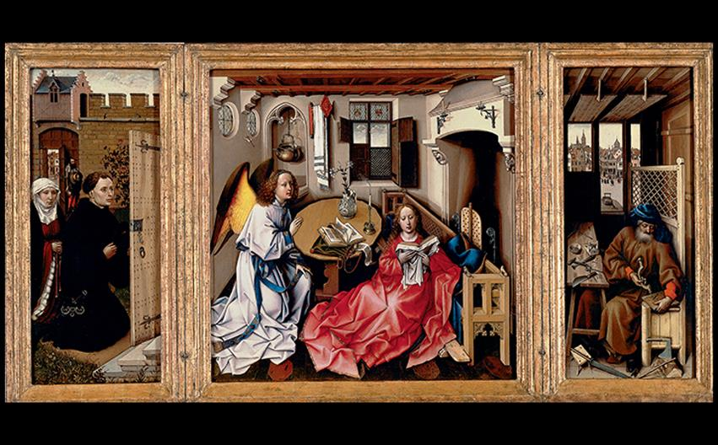
Workshop of the Master of Flémalle MÉRODE ALTARPIECE (TRIPTYCH OF THE ANNUNCIATION) (OPEN) c. 1425–1430s. Oil on wood panel, center 25-1/4" × 24-7/8" (64.1 × 63.2 cm); each wing approx. 25-3/8" × 10-3/4" (64.5 × 27.6 cm). Metropolitan Museum of Art, New York. The Cloisters Collection, 1956 (56.70). © 2016. Image copyright The Metropolitan Museum of Art/Art Resource/Scala, Florence.
Notes:
Workshop of the Master of Flémalle MÉRODE ALTARPIECE (TRIPTYCH OF THE ANNUNCIATION) (OPEN) c. 1425–1430s. Oil on wood panel, center 25-1/4" × 24-7/8" (64.1 × 63.2 cm); each wing approx. 25-3/8" × 10-3/4" (64.5 × 27.6 cm). Metropolitan Museum of Art, New York. The Cloisters Collection, 1956 (56.70). © 2016. Image copyright The Metropolitan Museum of Art/Art Resource/Scala, Florence.

Slide 31
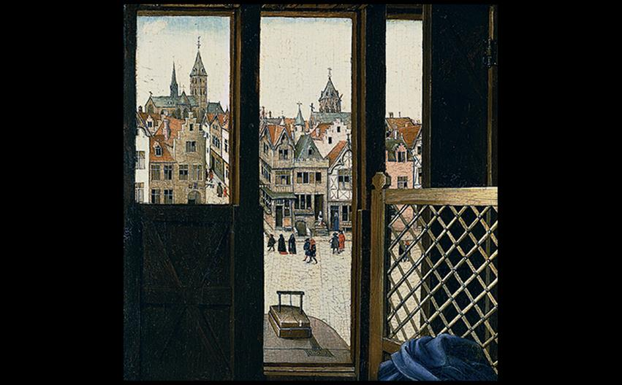
Workshop of the Master of Flémalle A FLEMISH CITY Detail of the right wing of the Mérode Altarpiece (FIG. 19-10). © 2016. Image copyright The Metropolitan Museum of Art/Art Resource/Scala, Florence.
Notes:
Workshop of the Master of Flémalle A FLEMISH CITY Detail of the right wing of the Mérode Altarpiece (FIG. 19-10). © 2016. Image copyright The Metropolitan Museum of Art/Art Resource/Scala, Florence.

Slide 32
Jan van Eyck (1 of 3)
Man in a Red Turban strongly presents the sitter's personality, and it may have even been a self-portrait.
A huge polyptych painted for the Cathedral of St. Bavo in Ghent is his best known work.

Slide 33
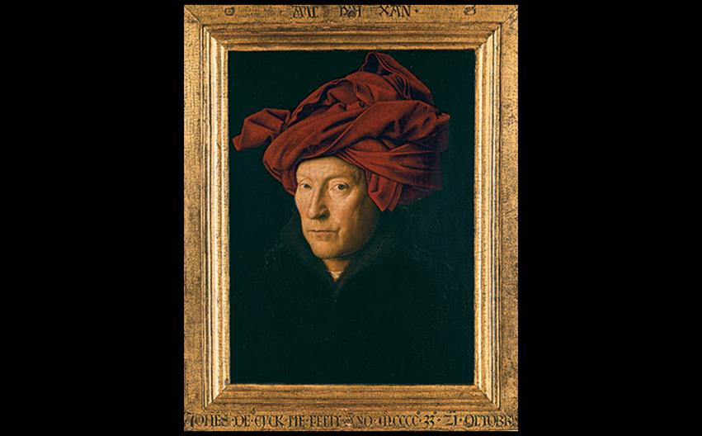
Jan van Eyck MAN IN A RED TURBAN 1433. Oil on wood panel, 13-1/8" × 10-1/4" (33.3 × 25.8 cm). National Gallery, London. © 2016. Copyright Scala, Florence.
Notes:
Jan van Eyck MAN IN A RED TURBAN 1433. Oil on wood panel, 13-1/8" × 10-1/4" (33.3 × 25.8 cm). National Gallery, London. © 2016. Copyright Scala, Florence.

Slide 34
Jan van Eyck (2 of 3)
The Ghent Alterpiece
The Ghent Altarpiece showed remarkable surface realism in textures such as jewels and human flesh.
Closed, its colors were muted and sober; when it opened on Sundays and feast days, it was vibrantly colored.
Some historians believe Hubert van Eyck began the painting, but others believed it was Jan's workshop.

Slide 35
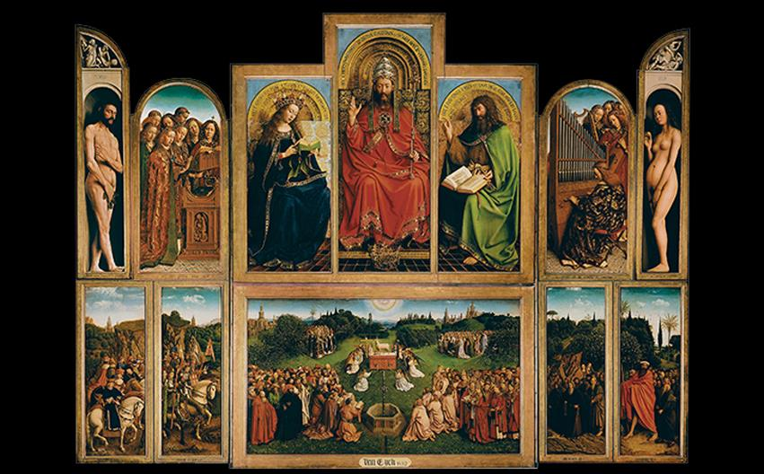
Jan and Hubert (?) van Eyck GHENT ALTARPIECE (OPEN), ADORATION OF THE MYSTIC LAMB Completed 1432. Oil on panel, 11'5-3/4" × 15'1-1/2" (3.5 × 4.6 m). Cathedral of St. Bavo, Ghent. © akg-images/Erich Lessing.
Notes:
Jan and Hubert (?) van Eyck GHENT ALTARPIECE (OPEN), ADORATION OF THE MYSTIC LAMB Completed 1432. Oil on panel, 11'5-3/4" × 15'1-1/2" (3.5 × 4.6 m). Cathedral of St. Bavo, Ghent. © akg-images/Erich Lessing.

Slide 36
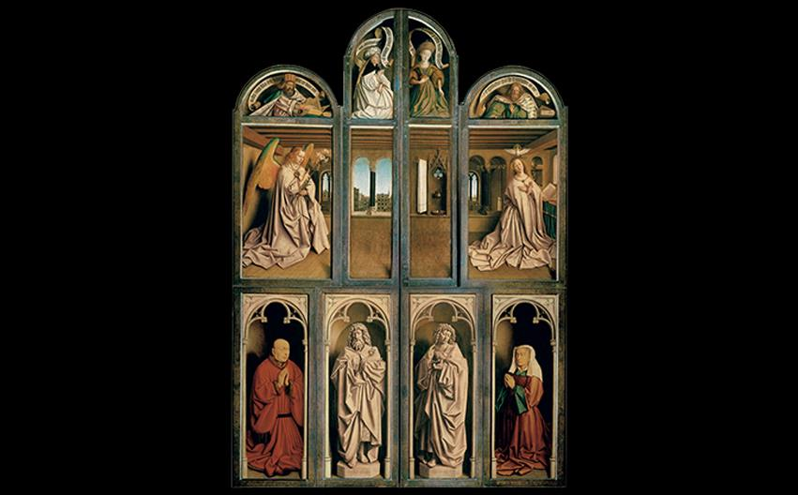
Jan and Hubert (?) van Eyck GHENT ALTARPIECE (CLOSED), ANNUNCIATION WITH DONORS Completed 1432. Oil on panel, height 11'5" (3.48 m). Cathedral of St. Bavo, Ghent. © akg-images/Erich Lessing
Notes:
Jan and Hubert (?) van Eyck GHENT ALTARPIECE (CLOSED), ANNUNCIATION WITH DONORS Completed 1432. Oil on panel, height 11'5" (3.48 m). Cathedral of St. Bavo, Ghent

Slide 37
Jan van Eyck (3 of 3)
The Arnolfini Double Portrait
Early interpretations pegged the double portrait of Giovanni Arnolfini and His Wife as a wedding commission, but it has later been identified as a commission for a prospective marriage.
The artist signed his name within the mirror on the back wall.

Slide 38
Rogier van der Weyden (1 of 2)
The peak of his career was spent in Brussels, where the artist was the official city painter.
Deposition presented a popular theme for the time because of its dramatic, personally engaging portrayal.
Mourners have individual reactions to the scene.
Color and pattern enhance this piece.

Slide 39
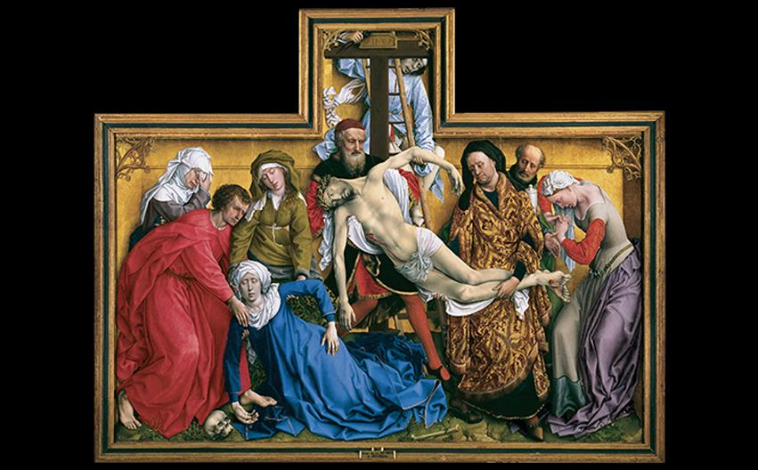
Rogier van der Weyden DEPOSITION From an altarpiece commissioned by the crossbowmen's guild, Louvain, Belgium. Before 1443, possibly c. 1435–1438. Oil on wood panel, 7'2-5/8" × 8'7-1/8" (2.2 × 2.62 m). Museo del Prado, Madrid. © 2016. Image Copyright Museo Nacional del Prado. © Photo MNP/Scala, Florence.
Notes:
Rogier van der Weyden DEPOSITION From an altarpiece commissioned by the crossbowmen's guild, Louvain, Belgium. Before 1443, possibly c. 1435–1438. Oil on wood panel, 7'2-5/8" × 8'7-1/8" (2.2 × 2.62 m). Museo del Prado, Madrid. © 2016. Image Copyright Museo Nacional del Prado. © Photo MNP/Scala, Florence.

Slide 40
Rogier van der Weyden (2 of 2)
St. Luke Drawing the Virgin and Child is based on legend that Luke witnessed a miraculous appearance of the Virgin and Child so he could record their likenesses.
Art historians interpret it as a document of Rogier's sense of his profession; they also assert that it elevates the importance of painting as profession.

Slide 41
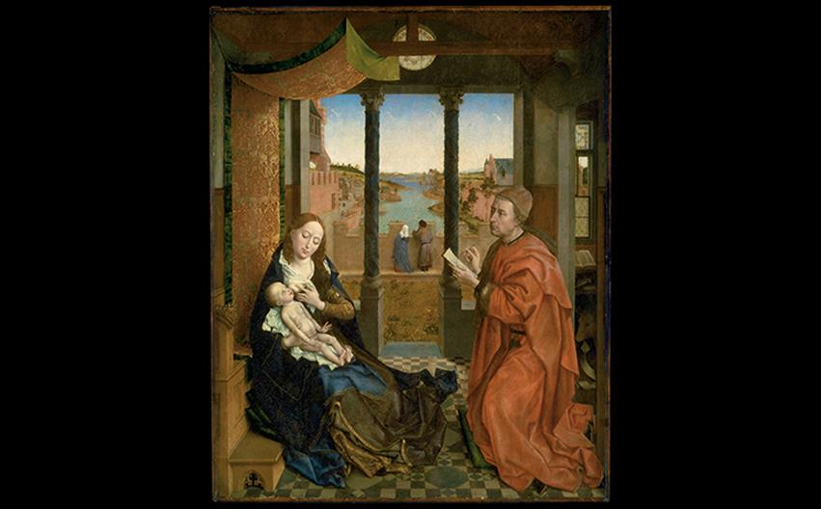
Rogier van der Weyden ST. LUKE DRAWING THE VIRGIN AND CHILD c. 1435–1440. Oil and tempera on wood panel, 54-1/4" × 43-5/8" (137.7 × 110.8 cm). Museum of Fine Arts, Boston. Photograph © 2017 Museum of Fine Arts, Boston.
Notes:
Rogier van der Weyden ST. LUKE DRAWING THE VIRGIN AND CHILD c. 1435–1440. Oil and tempera on wood panel, 54-1/4" × 43-5/8" (137.7 × 110.8 cm). Museum of Fine Arts, Boston. Photograph © 2017 Museum of Fine Arts, Boston.

Slide 42
Painting at Mid Century: The Second Generation (1 of 3)
The second generation of Flemish painters produced work that was simpler, more direct, and easier to understand.
However, the work was more emotionally complex.

Slide 43
Painting at Mid Century: The Second Generation (2 of 3)
Petrus Christus
The artist painted a portrait of a goldsmith serving two customers.
Originally thought to be an image of St. Eloi, it was reevaluated in 1993 as a portrait of an actual goldsmith.

Slide 44
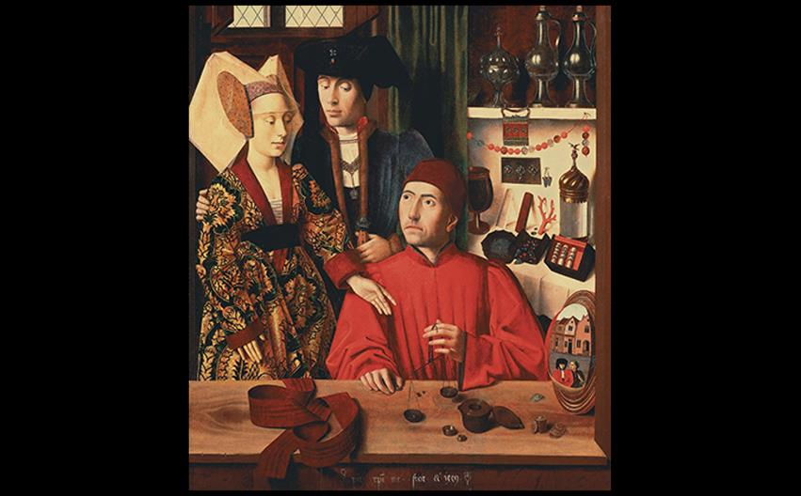
A CLOSER LOOK: A Goldsmith in his Shop by Petrus Christus 1449. Oil on oak panel, 38-5/8 × 33-1/2" (98 × 85 cm). Metropolitan Museum of Art, New York. Robert Lehman Collection, 1975. 1975.1.110. © 2016. Image copyright The Metropolitan Museum of Art/Art Resource/Scala, Florence.
Notes:
A CLOSER LOOK: A Goldsmith in his Shop by Petrus Christus 1449. Oil on oak panel, 38-5/8 × 33-1/2" (98 × 85 cm). Metropolitan Museum of Art, New York. Robert Lehman Collection, 1975. 1975.1.110. © 2016. Image copyright The Metropolitan Museum of Art/Art Resource/Scala, Florence.

Slide 45
Painting at Mid Century: The Second Generation (3 of 3)
Dieric Bouts
Virgin and Child, at 8-1/2" tall, is an intimate rendering of a private moment between mother and child.
Both subjects look like people who would have existed during the artist's time.

Slide 46
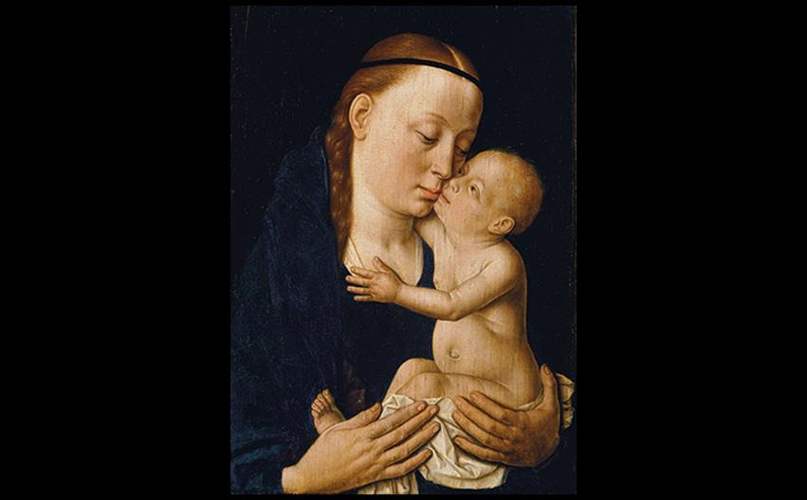
Dieric Bouts VIRGIN AND CHILD c. 1455–1460. Oil on wood panel, 8-1/2" × 6-1/2" (21.6 × 16.5 cm). Metropolitan Museum of Art, New York. © 2016. Image copyright The Metropolitan Museum of Art/Art Resource/Scala, Florence.
Notes:
Dieric Bouts VIRGIN AND CHILD c. 1455–1460. Oil on wood panel, 8-1/2" × 6-1/2" (21.6 × 16.5 cm). Metropolitan Museum of Art, New York. © 2016. Image copyright The Metropolitan Museum of Art/Art Resource/Scala, Florence.

Slide 47
Hugo van der Goes and Hans Memling (1 of 3)
The Portinari altarpiece was exceptionally large and its patrons were portrayed on the wing interiors.
Its theme was the Nativity as told by Luke.
Meadows and woods are meticulously painted and light plays a large role.
Symbols that viewers would have interpreted dot this work.

Slide 48
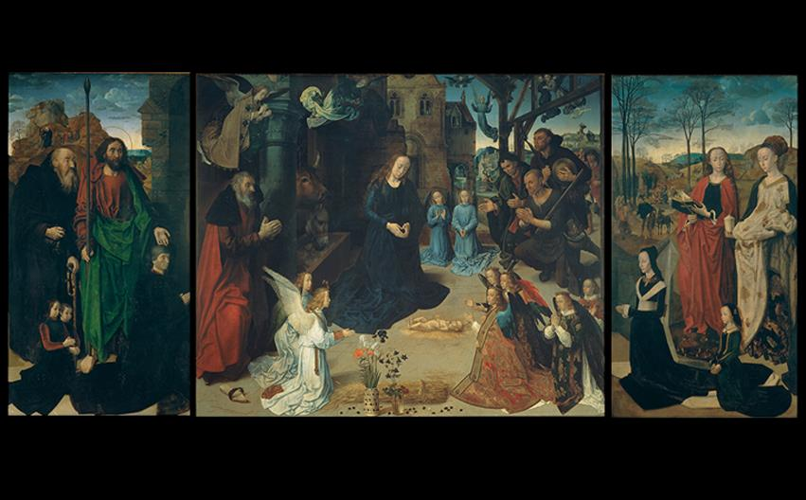
Hugo van der Goes PORTINARI ALTARPIECE (OPEN) c. 1474–1476. Tempera and oil on wood panel; center 8'3-1/2" × 10' (2.53 × 3.01 m), wings each 8'3-1/2" × 4'7-1/2" (2.53 × 1.41 m). Galleria degli Uffizi, Florence. © Studio Fotografico Quattrone, Florence.
Notes:
Hugo van der Goes PORTINARI ALTARPIECE (OPEN) c. 1474–1476. Tempera and oil on wood panel; center 8'3-1/2" × 10' (2.53 × 3.01 m), wings each 8'3-1/2" × 4'7-1/2" (2.53 × 1.41 m). Galleria degli Uffizi, Florence. © Studio Fotografico Quattrone, Florence.

Slide 49
Hugo van der Goes and Hans Memling (2 of 3)
Hans Memling
Memling combines intellectual depth and technical rendering with a delicacy of feeling and "prettiness."
He was commissioned to create a diptych of the Virgin and Child as appearing fictionally in the home of Maarten van Nieuwenhove.

Slide 50
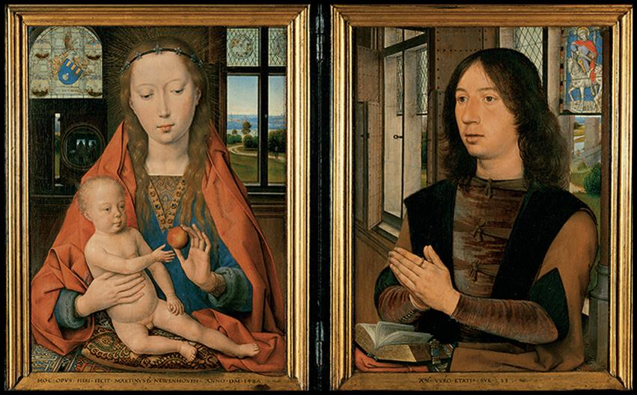
Hans Memling DIPTYCH OF MAARTEN VAN NIEUWENHOVE 1487. Oil on wood panel, each panel (including frames) 20-1/2" × 16-1/4" (52 × 41.5 cm). Hans Memling Museum, Musea Brugge, Sint-Jans Hospital, Bruges. © akg-images/Erich Lessing.
Notes:
Hans Memling DIPTYCH OF MAARTEN VAN NIEUWENHOVE 1487. Oil on wood panel, each panel (including frames) 20-1/2" × 16-1/4" (52 × 41.5 cm). Hans Memling Museum, Musea Brugge, Sint-Jans Hospital, Bruges. © akg-images/Erich Lessing.

Slide 51
Hugo van der Goes and Hans Memling (3 of 3)
Hans Memling
Memling's construction of a coherent space is impressive in this format.
The Virgin's scarlet mantle extends under the division of the two wings to connect the pieces and rests under Maarten's Book of Hours.
A convex mirror reflects the backs of both Maarten and Mary.

Slide 52
France
Under the rule of Charles VII and Louis XI, the French royal court became a major source for patronage of the arts.

Slide 53
Jean Fouquet and Jean Hey (1 of 3)
Jean Fouquet
Fouquet drew from contemporary Italian Classicism and Flemish illusionism.
A diptych was commissioned for Étienne Chevalier to put over the tomb of his wife.

Slide 54
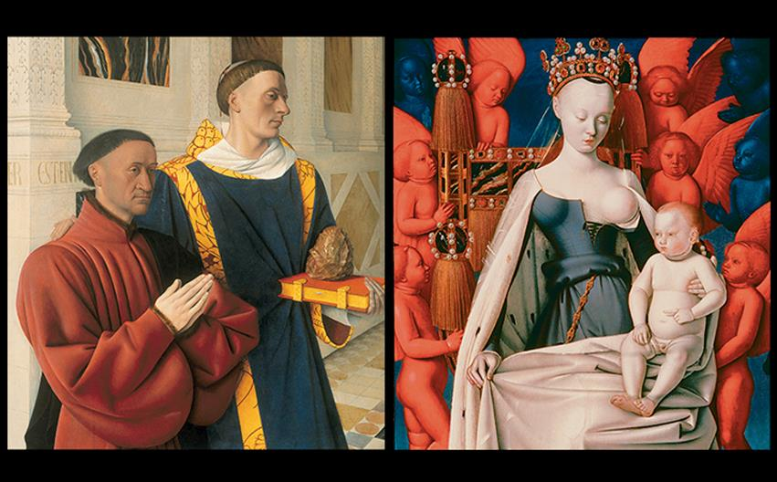
Jean Fouquet ÉTIENNE CHEVALIER AND ST. STEPHEN, VIRGIN AND CHILD The Melun Diptych. c. 1452–1455. Oil on oak panel. Left wing: 36-1/2" × 33-1/2" (92.7 × 85.5 cm), Staatliche Museen zu Berlin, Preussischer Kulturbesitz, Gemäldegalerie. ; right wing: 37-1/4 × 33-1/2" (94.5 × 85.5 cm), Koninklijk Museum voor Schone Kunsten, Antwerp, Belgium. © 2016. Photo Scala, Florence/bpk, Bildagentur für Kunst, Kultur und Geschichte, Berlin
Notes:
Jean Fouquet ÉTIENNE CHEVALIER AND ST. STEPHEN, VIRGIN AND CHILD The Melun Diptych. c. 1452–1455. Oil on oak panel. Left wing: 36-1/2" × 33-1/2" (92.7 × 85.5 cm), Staatliche Museen zu Berlin, Preussischer Kulturbesitz, Gemäldegalerie. ; right wing: 37-1/4 × 33-1/2" (94.5 × 85.5 cm), Koninklijk Museum voor Schone Kunsten, Antwerp, Belgium. © 2016. Photo Scala, Florence/bpk, Bildagentur für Kunst, Kultur und Geschichte, Berlin

Slide 55
Jean Fouquet and Jean Hey (2 of 3)
Jean Fouquet
The left panel of the diptych features saint Stephen presenting the patron to the Virgin and Child in the adjacent panel.
The right panel of the diptych presents a supernatural, abstracted vision of the Virgin holding a substantial baby Christ.

Slide 56
Jean Fouquet and Jean Hey (3 of 3)
Jean Hey, the Master of Moulins
The charming portrait of Margaret of Austria may have originally been a diptych.
Hey captures "Cs" and "Ms" embroidered on her collar that would have signaled her betrothal to Charles VIII, to whom she had been betrothed at age 2 or 3.
Her facial features are delicate and vulnerable.

Slide 57
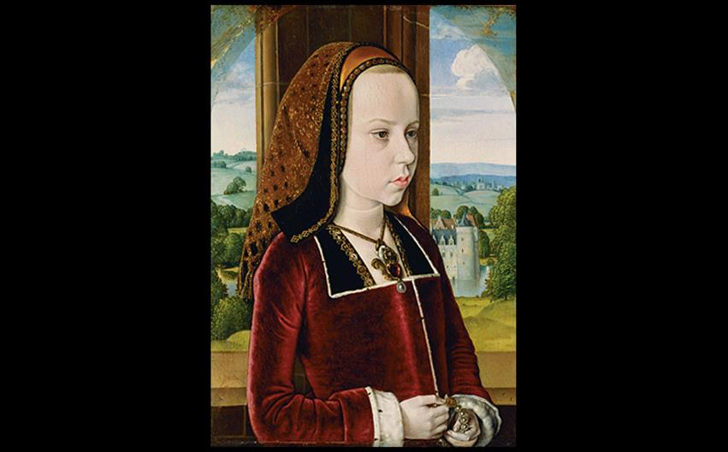
Jean Hey (The Master of Moulins) PORTRAIT OF MARGARET OF AUSTRIA c. 1490. Oil on wood panel, 12-7/8" × 9-1/8" (32.7 × 23 cm). Metropolitan Museum of Art, New York. Robert Lehman Collection. © 2016. Image copyright Resource/Scala, Florence.
Notes:
Jean Hey (The Master of Moulins) PORTRAIT OF MARGARET OF AUSTRIA c. 1490. Oil on wood panel, 12-7/8" × 9-1/8" (32.7 × 23 cm). Metropolitan Museum of Art, New York. Robert Lehman Collection. © 2016. Image copyright Resource/Scala, Florence

Slide 58
Flamboyant Architecture
The Church of Saint-Maclou in Rouen is a well-preserved example.
Designed by Pierre Robin, it featured repeated, twisted, flamelike tracery.
The house of Jacques Couer also retains flamboyant elements.
It is built around an irregular, open courtyard; tympana over doors indicate functions of the room within.

Slide 59
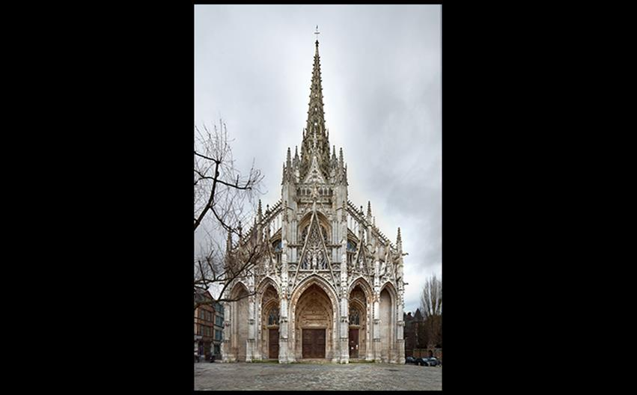
Pierre Robin (?) CHURCH OF SAINT-MACLOU, ROUEN Normandy, France. West façade, 1432–1521; façade c. 1500–1514 © Achim Bednorz, Cologne.
Notes:
Pierre Robin (?) CHURCH OF SAINT-MACLOU, ROUEN Normandy, France. West façade, 1432–1521; façade c. 1500–1514 © Achim Bednorz, Cologne.

Slide 60
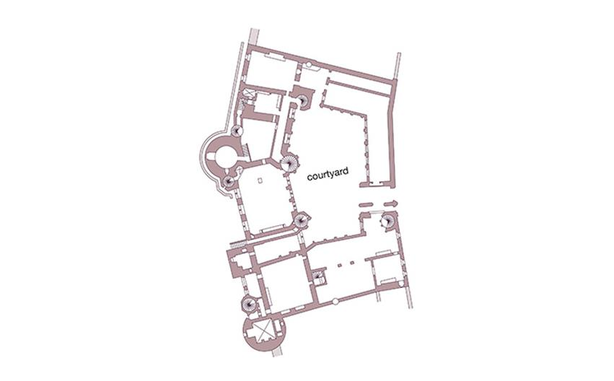
PLAN OF JACQUES COEUR HOUSE Bourges, France. 1443–1451.
Notes:
PLAN OF JACQUES COEUR HOUSE Bourges, France. 1443–1451.

Slide 61
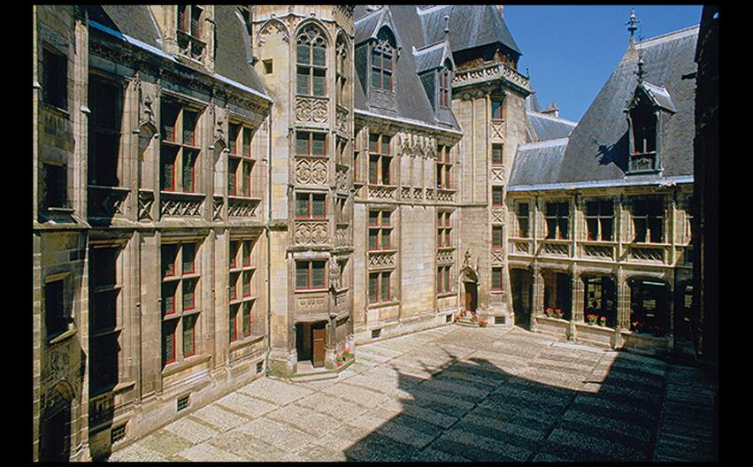
INTERIOR COURTYARD OF JACQUES COEUR HOUSE Bourges, France. 1443–1451. © Hervé Champollion/akg-images.
Notes:
INTERIOR COURTYARD OF JACQUES COEUR HOUSE Bourges, France. 1443–1451. © Hervé Champollion/akg-images.

Slide 62
The Germanic Lands
Artisan guilds grew powerful and trade flourished under the Hanseatic League.
Konrad Witz
Witz found patronage through the Church.
Miraculous Draft of the Fishes sets the biblical scene on the Lake of Geneva, enhancing every surface texture with great detail.

Slide 63
Painting and Sculpture (1 of 2)
Konrad Witz
Witz found patronage through the Church.
Miraculous Draft of the Fishes sets the biblical scene on the Lake of Geneva, enhancing every surface texture with great detail.

Slide 64
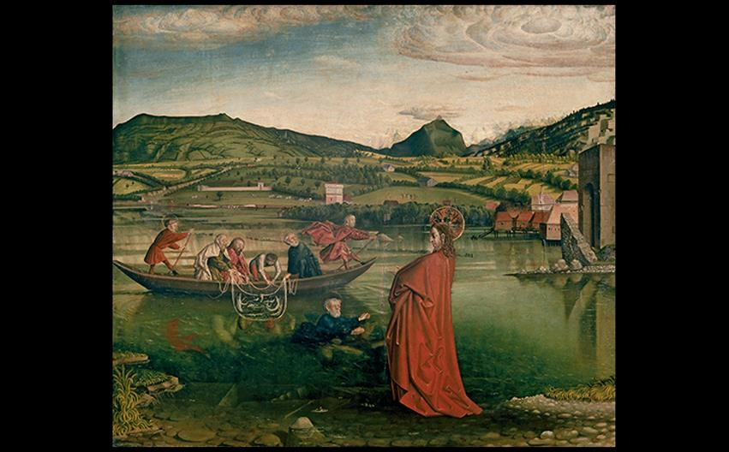
Konrad Witz MIRACULOUS DRAFT OF FISHES From an altarpiece for the Cathedral of St. Peter, Geneva, Switzerland. 1444. Oil on wood panel, 4'3" × 5'1" (1.29 × 1.55 m). Musée d'Art et d'Histoire, Geneva. © Musée d'art et d'histoire, Ville de Genève. Photo: Flora Bevilacqua.
Notes:
Konrad Witz MIRACULOUS DRAFT OF FISHES From an altarpiece for the Cathedral of St. Peter, Geneva, Switzerland. 1444. Oil on wood panel, 4'3" × 5'1" (1.29 × 1.55 m). Musée d'Art et d'Histoire, Geneva. © Musée d'art et d'histoire, Ville de Genève. Photo: Flora Bevilacqua.

Slide 65
Painting and Sculpture (2 of 2)
Michael Pacher
Painter and sculptor Pacher was commissioned for a large altarpiece that survives in its original setting.
Open, it shows a sculptural ensemble flanked by four panel paintings.
Other artists collaborated with him for the execution of the work.
The use of soft wood allowed for high detailing.

Slide 66
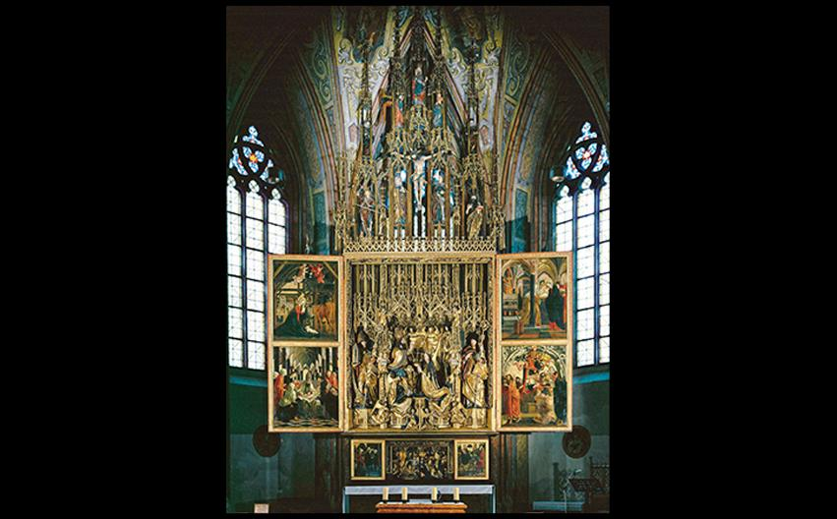
Michael Pacher ST. WOLFGANG ALTARPIECE Church of St. Wolfgang, Austria. 1471–1481. Carved, painted, and gilt wood; wings are oil on wood panel. © akg-images/Erich Lessing.
Notes:
Michael Pacher ST. WOLFGANG ALTARPIECE Church of St. Wolfgang, Austria. 1471–1481. Carved, painted, and gilt wood; wings are oil on wood panel. © akg-images/Erich Lessing.

Slide 67
Technique: Woodcuts and Engravings on Metal
Woodcuts are made by cutting away areas around drawn lines on a block, leaving the lines in high relief.
Engraving uses burins to cut into the metal plate.
Making multiple prints from a single version was a team effort.

Slide 68
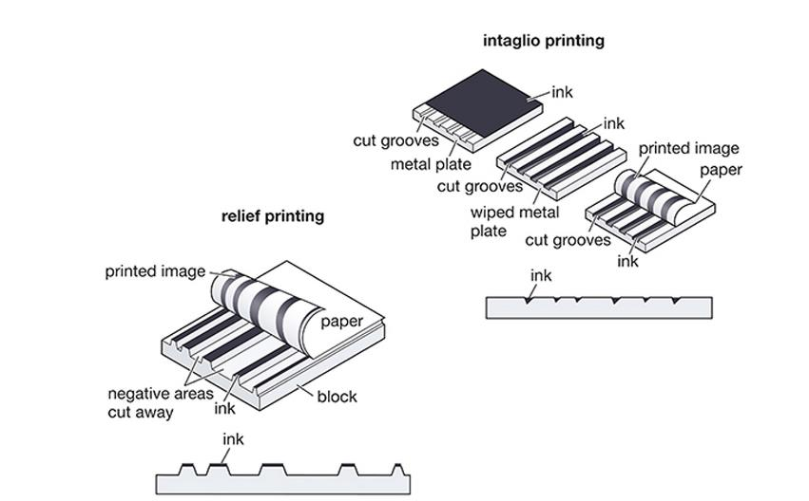
TECHNIQUE: Woodcuts and Engravings of Metal
Notes:
TECHNIQUE: Woodcuts and Engravings of Metal

Slide 69
The Graphic Arts (1 of 3)
Only in the fifteenth century did woodblock printing of images and text on paper replace copying of each book by hand.
Woodcut and engraving were techniques used by printmakers.

Slide 70
The Graphic Arts (2 of 3)
The Buxheim St. Christopher
This devotional image was glued to the inside cover of another manuscript.
Both the cutting of the block and the printing itself are high quality with varying line widths.

Slide 71
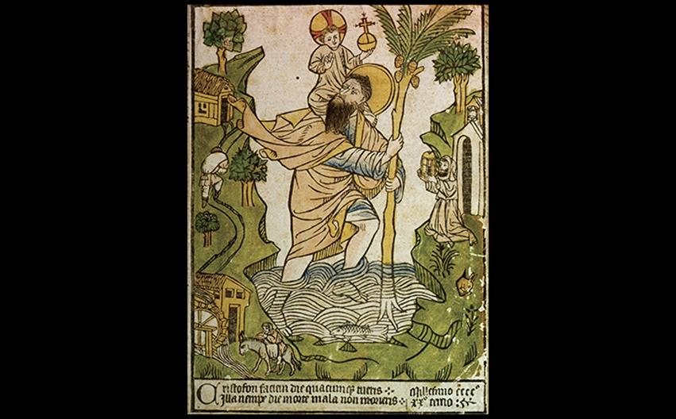
THE BUXHEIM ST. CHRISTOPHER Mid 15th century. Hand-colored woodcut, 11-3/8" × 8-1/8" (28.85 × 20.7 cm). Private collection. © Fine Art Images/Archivi Alinari, Firenze.
Notes:
THE BUXHEIM ST. CHRISTOPHER Mid 15th century. Hand-colored woodcut, 11-3/8" × 8-1/8" (28.85 × 20.7 cm). Private collection. © Fine Art Images/Archivi Alinari, Firenze.

Slide 72
The Graphic Arts (3 of 3)
Martin Schongauer
Schongauer learned the technique from his father and produced The Temptations of St. Anthony.
The moment is presented as a horrifying assault, but the saint shows no sign of torment due to his inner focus.

Slide 73
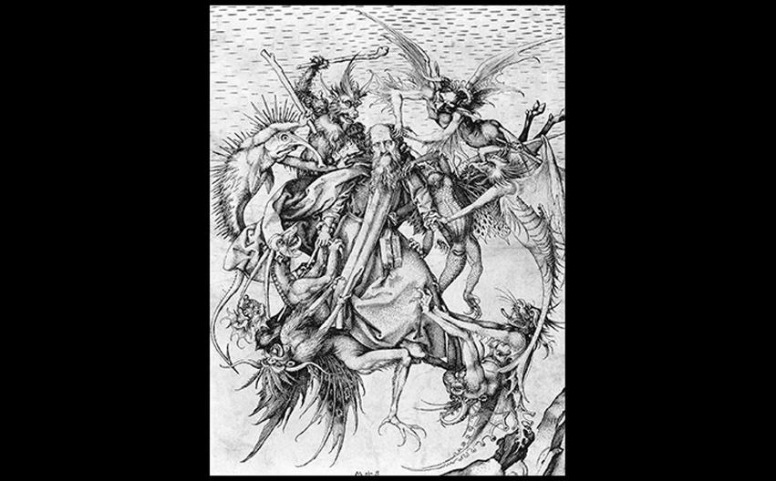
Martin Schongauer THE TEMPTATIONS OF ST. ANTHONY c. 1470–1480. Engraving, 12-1/4" × 9" (31.1 × 22.9 cm). Metropolitan Museum of Art, New York. Rogers Fund, 1920 (20.5.2). © 2016. Image copyright The Metropolitan Museum of Art/Art Resource/Scala, Florence.
Notes:
Martin Schongauer THE TEMPTATIONS OF ST. ANTHONY c. 1470–1480. Engraving, 12-1/4" × 9" (31.1 × 22.9 cm). Metropolitan Museum of Art, New York. Rogers Fund, 1920 (20.5.2). © 2016. Image copyright The Metropolitan Museum of Art/Art Resource/Scala, Florence.

Slide 74
Printed Books (1 of 2)
The use of woodcuts for printmaking began to replace written manuscripts.
Movable-type printing was achieved with the Gutenberg press.
This allowed for a number of identical books to be made concurrently.
Rapid spread of these texts enhanced intellectual and spiritual life across Europe.

Slide 75
Printed Books (2 of 2)
The Nuremburg Chronicle
The Nuremburg Chronicle was published in 1493 and contained 1,809 woodcut illustrations.
The panoramic City of Nuremburg spread was painted by hand with color to enhance its appeal.

Slide 76
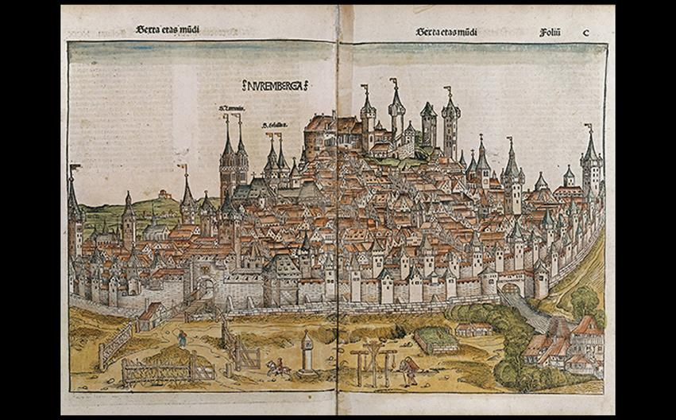
Michael Wolgemut, Wilhelm Pleydenwurff, and workshop THE CITY OF NUREMBERG Nuremberg Chronicle, published by Anton Koberger in 1493. Woodcut within a printed book, hand-colored after printing, each page 18-1/2" × 12-3/4" (47 × 32.4 cm). Staatliche Museen zu Berlin. © 2016. Photo Scala, Florence/bpk, Bildagentur für Kunst, Kultur und Geschichte, Berlin.
Notes:
Michael Wolgemut, Wilhelm Pleydenwurff, and workshop THE CITY OF NUREMBERG Nuremberg Chronicle, published by Anton Koberger in 1493. Woodcut within a printed book, hand-colored after printing, each page 18-1/2" × 12-3/4" (47 × 32.4 cm). Staatliche Museen zu Berlin. © 2016. Photo Scala, Florence/bpk, Bildagentur für Kunst, Kultur und Geschichte, Berlin.

